Slide 1
Real Estate Project
UCB Boot Camp
Team: Bharat, Gokul, Ritesh, Devang

Slide 2
Project : Real Estate Investment Tool
Project Description / Outline :
Real estate industry plays a significant role in driving the economy and development of the country.
With increasingly high demand and scarce land, real estate development especially housing is caught in a vicious circle which is impacted by various factors – school ratings, crime rate, employment rate, …
The purpose of this research is to create a tool that visualizes the average sale price and shows how it is affected by other factors.
Using this tool, you can visualize and download housing market data trend and impacts of these factors for metropolitan area, cities, counties across the state CA and help users for areas of investment.

Slide 3
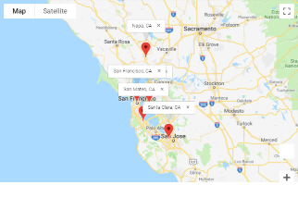
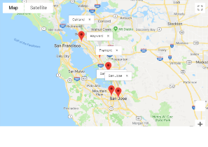
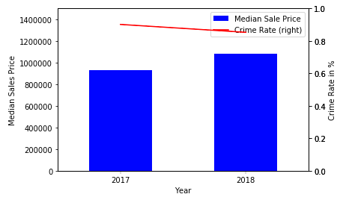
Project : Real Estate Investment Tool
Project Modules / flow :
Input
Input
Processing
OutPut
Processing
Output
School Ratings
City/County
Median sales data
School Raking
Crime Rate
Employment Rate
Visualizations
Real Estate Data
Crime Rate
Employment Rate

Slide 4
Project : Real Estate Investment Tool
Real Estate Module Description:
This module gives insight and most reliable data on the state of the housing market. Using the tools you can visualize and download housing market data for metropolitan areas, cities and counties across CA.
Here’s what’s available:
Median sale price for past years
Median sale price month wise for a year
Map visualization showing markers for cities and its median sale price for a year within a metropolitan area
How it Works:
User selects the type of data that user is looking for.
Under each selection, user selects search type – visualize for a year or trend of place
Visualize for a year - User enters – year, metropolitan area
Trend of a place – User enters - past years or for a year, city or county
Each visualization will change with user selection. After making the selection, the visualization is displayed. The user can download the map visualization and/or will get the visualization copied/stored as .png file.

Slide 5
Project : Real Estate Investment Tool
Real Estate Module Output/Visualizations:

Slide 6
Project : Real Estate Investment Tool
References :
https://www.redfin.com/blog/data-center: Real estate data
Geocode api: to fetch latitude/longitude
Geomap api: to visualize real estate data

Slide 7
Project : Real Estate Investment Tool
Crime Rate Module Description:
The decisions of buyers on the housing market are not only the sum of their subjective expectations but also of the perception of real estate through a prism of opinions and suggestions arising from the surroundings. One of the basic criteria driving households determined to meet basic housing needs is security. The aim of the study is to identify the relationship between the transaction prices of housing and the crime rate in the various districts of Szczecin. For this purpose, data from the California are analyzed in the work.
How it Works:
Inputs: Crime data CSV file and merged with Output CSV file from Real Estate Module
For the list of Cities in the file from the Real Estate Module – visualize the Crime and its impact to Real Estate (Median Sales Price)
Dual Axis Graph for each city (With a Bar Graph for Medial Sales Price and Line Graph for Crime Data over years)
Bar Graphs for the years 2017 and 2018 displaying the Crime Rate for the Cities selected
Each visualization will display data for the number of cities available in the Real Estate Module. The visualization are displayed. The user can download the map visualization and/or will get the visualization copied/stored as .png file.

Slide 8
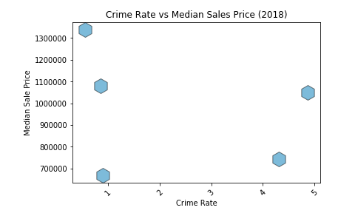
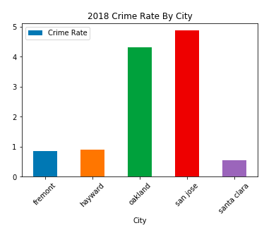
Project : Real Estate Investment Tool
Crime Data Output/Visualizations:
Dual Axis Graph

Slide 9
Project : Real Estate Investment Tool
References :
https://www.ucrdatatool.gov/Search/Crime/State/StatebyState.cfm: Crime data (for California only)
Geocode api: to fetch latitude/longitude

Slide 10
Project Title : RealEstate Investment Tool (Cont..)
Data Sets to be Used
City zipcode
Housing sales
Crime Index per city
Employment rate
Mortgate interest rate
Stock Index
Rough Breakdown of Tasks
Fetch Real estate, school rating, crime rate, employment rate/index, stock market index, mortgage interest rate data for past years (prefer 10~15 years)
- Prepare housing price trend from the correlation of the collected data for past years
- Prepare a heat map showing current housing investment opportunities
- Utilize this past data to make predictions for future investment opportunities

